Slide 1
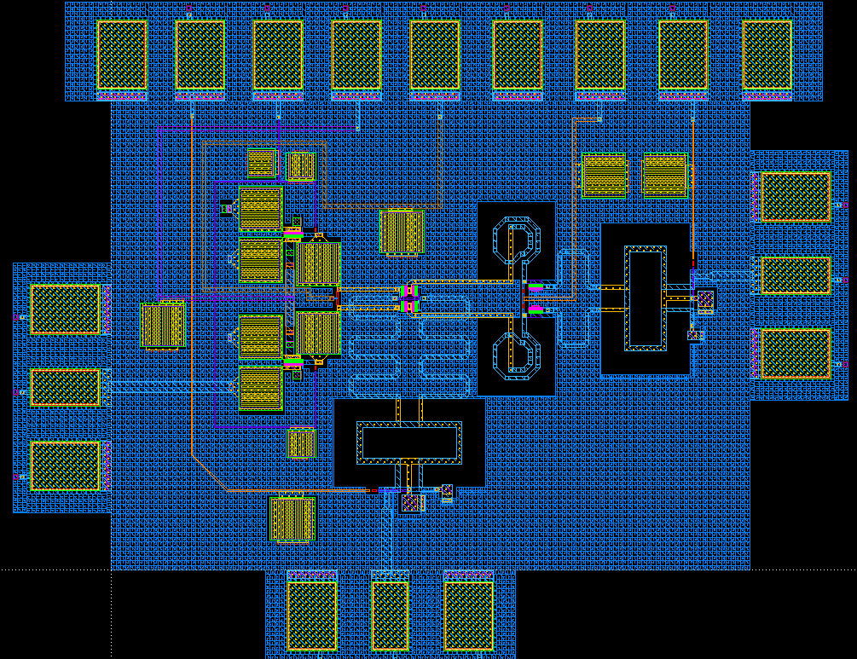
Design of Q-band gilbert cell down conversion mixer using 65nm CMOS technology
Hyunkyu Lee, Seungwon Park and Sanggeun Jeon
School of Electrical Engineering, Korea University, Seoul 136-713, Korea
Introduction
Necessity of down conversion mixer
  Homodyne receiver structures enable low cost integrated transceiver MMICs.
  High isolation down conversion mixer is essential circuit that composes homodyne receiver.
Advantage of gilbert cell down conversion mixer
  Lower conversion loss than passive type mixer.
  Higher isolation performance than other topology.
Design
Q-band down conversion mixer is designed using gilbert cell topology for high conversion gain and isolation performance.
Current bleeding path is inserted for reducing voltage drop caused by load resistor R_{L}.
RF and LO matching network are composed of balun and series line(TL₁, TL₂) for broad band matching performance.
Two series inductor Ls are inserted in signal path for enhancing broad bandwidth performance.
Source follower buffer is used for improving isolation and IF matching performance.
LO
Input
IF
Output
RF
Input
Results
Q-band down conversion mixer is designed using 65-nm CMOS technology.
Maximum conversion gain is -0.8dB and 3dB bandwidth is 3.3GHz (0.4 - 3.7GHz)
Input P1dB is -13dBm with 40GHz 3dBm LO signal.
Chip size is 1070ⅹ850 um² including DC & RF probing pads.
DC power consumption of down conversion mixer is 8.46mW.
(Core : 4.57mW, buffer : 3.89mW)
Conclusion
Q-band down conversion mixer is designed using 65-nm CMOS technology.
Designed down conversion mixer has 0.8dB conversion loss and 3.3GHz 3dB IF bandwidth with 8.46mW DC power consumption.
The authors thank IDEC for MPW and CAD tool support

